Slide 1
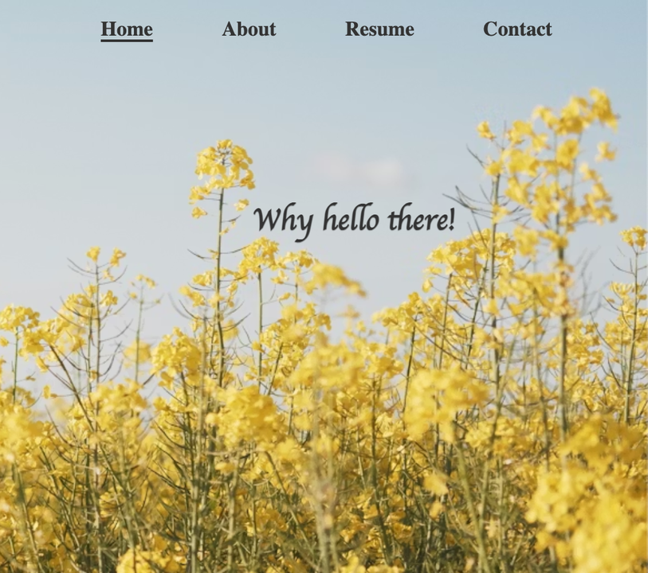

elizabethmostellar.pythonanywhere.com
A project showcasing my coding skills to future employers
PERSONAL RESUME WEBSITE
Coder:
Elizabeth Mostellar

